Slide 1
Income Classification using Machine Learning: A Comparative Study of Algorithms
By
Muthamilarasu NARAYANASAMY

Slide 2
What is Machine Learning?
A branch Of artificial intelligence, concerned with the design and development of algorithms that allow computers to evolve behaviour’s based on empirical data
A computer program is said to learn from experience E with respect to some class of tasks T and performance measure P if its performance at tasks in T, as measured by P, improves with experience E.
Using known data, develop a model to predict unknown data.
Known Data: Big enough archive, previous observations, past data
Model: Known data + Algorithms (ML algorithms)
Unknown Data: Missing, Unseen, not existing, future data

Slide 3
Learning system Models
TESTING
INPUT SAMPLES
LEARNING METHOD
SYSTEM
TRAINING

Slide 4
Why ML?
No human experts
industrial/manufacturing control.
mass spectrometer analysis, drug design, astronomic discovery
Black-box human expertise
face/handwriting/speech recognition.
driving a car, flying a plane.
personalized news reader.
movie/book recommendation
Rapidly changing phenomena
credit scoring, financial modelling
diagnosis, fraud detection.

Slide 5
TYPES OF MACHINE LEARNING
MACHINE LEARNING
SUPERVISED MACHINE LEARNING
(TASK DRIVEN)
Regression
Classification
UNSUPERVISED MACHINE LEARNING
(Data Driven)
Clustering
Probability distribution estimation
Finding association (in features)
Dimension reduction
REINFORCEMENT LEARNING
(Learning from Mistakes)
Playing Games

Slide 6
Classification
Predicting a qualitative response for an observation can be referred to as classifying that observation since it involves assigning the observation to a category, or class.
On the other hand, often the methods used for classification first predict the probability of each of the categories of a qualitative variable, as the basis for making the classification.
Methods:
There are many possible classification techniques, or classifiers, that one might use to predict a qualitative response including,
Logistic Regression
Linear Discriminant Analysis (LDA)
K-Nearest Neighbours (KNN)
Trees, Random Forests, and Boosting
Support Vector Machines (SVM)
Neural Networks

Slide 7
Introduction to income classification dataset
The World Bank has used an income classification to group countries for analytical purposes for many years. Since the present income classification was first introduced 25 years ago there has been significant change in the global economic landscape.
As real incomes have risen, the number of countries in the low income group has fallen to 31, while the number of high income countries has risen to 80.
As countries have transitioned to middle income status, more people are living below the World Bank's international extreme poverty line in middle income countries than in low income countries.
These changes in the world economy, along with a rapid increase in the user base of World Bank data, suggest that a review of the income classification is needed

Slide 8
UCI repository Adult dataset is an open to all dataset. It consists of 15 attributes and a class label telling whether the income of the individual is less than or more than 50K a year.
These attributes range from the age of the person, the working class label to relationship status and the race the person belongs to.
The dataframe consists of information about the Income based on the various features like country, occupation, sex, martial status, workclass, hours per week etc.., which have 15 variations with 8965 observations.

Slide 9
LIST OF ATTRIBUTES
age: continuous.
work class: Private, Self-emp-not-inc, Self-emp-inc, Federal-gov, Local-gov, State-gov, Without-pay, Never-worked.
fnlwgt: continuous.
education: Bachelors, Some-college, 11th, HS-grad, Prof-school, Assoc-acdm, Assoc-voc, 9th, 7th-8th, 12th, Masters, 1st-4th, 10th, Doctorate, 5th-6th, Preschool.
education-num: continuous.
marital-status: Married-civ-spouse, Divorced, Never-married, Separated, Widowed, Married-spouse-absent, Married-AF-spouse.

Slide 10
occupation: Tech-support, Craft-repair, Other-service, Sales, Exec-managerial, Prof-specialty, Handlers-cleaners, Machine-op-inspct, Adm-clerical, Farming-fishing,
Transport-moving, Priv-house-serv, Protective-serv, Armed-Forces.
relationship: Wife, Own-child, Husband, Not-in-family, Other-relative, Unmarried.
race: White, Asian-Pac-Islander, Amer-Indian-Eskimo, Other, Black.
sex: Female, Male.
capital-gain: continuous.
capital-loss: continuous.
hours-per-week: continuous.
native-country: United-States, Cambodia, England, Puerto-Rico, Canada, Germany, Outlying-US(Guam-USVI-etc), India, Japan, Greece, South, China, Cuba, Iran, Honduras, Philippines, Italy, Poland, Jamaica, Vietnam, Mexico, Portugal, Ireland, France, Dominican-Republic, Laos, Ecuador, Taiwan, Haiti, Columbia, Hungary, Guatemala, Nicaragua, Scotland, Thailand, Yugoslavia, El-Salvador, Trinadad&Tobago, Peru, Hong, Holand-Netherlands.

Slide 11
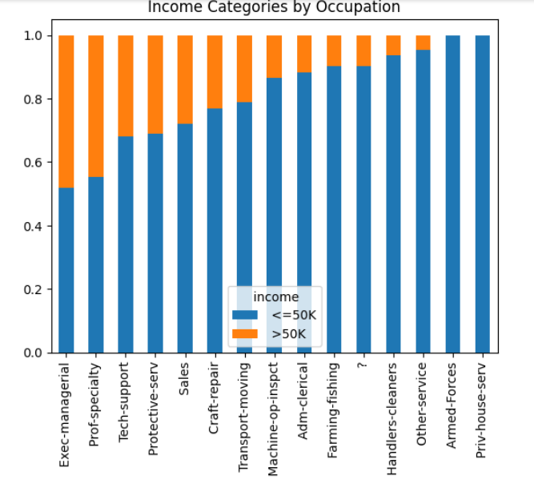
Income Categories by occupation

Slide 12
comparison WITH THE algorithms OF ML
CLASSIFICATION
Decision Tree Classifier
Decision tree classifier is its ability to using different feature subsets and decision rules at different stages of classification.
General decision tree consists of one root node, a number of internal and leaf nodes, and branches. Leaf nodes indicate the class to be assigned to a sample.
Decision tree classifier score- 0.8342007434944237

Slide 13
Random Forest Classifier
Random Forest is a popular machine learning algorithm used for classification and regression tasks due to its high accuracy, robustness, feature importance, versatility, and scalability.
Random Forest reduces overfitting by averaging multiple decision trees and is less sensitive to noise and outliers in the data.
Random forest classifier score- 0.9992848970251716
Logistic Regression Classifier
Logistic Regression is a statistical approach and a Machine Learning algorithm that is used for classification problems and is based on the concept of probability. It is used when the dependent variable (target) is categorical.
Logistic regression classifier score- 0.801593625498008

Slide 14
Support Vector Classifier
The advantages of support vector machines are: Effective in high dimensional spaces. Still effective in cases where number of dimensions is greater than the number of samples.
Support Vector Classifier score-0.7609561752988048
Multinomial Naive Bayes classifier
It is very useful to use on a dataset that is distributed multinomially
Multinomial Naive Bayes (MNB) is a popular machine learning algorithm for text classification problems that involve text data with discrete features such as word frequency counts.
Multinomial Naive Bayes classifier score -0.5227091633466135

Slide 15
K-Nearest Neighbours Classifier
It is commonly used for simple recommendation systems, pattern recognition, data mining, financial market predictions, intrusion detection, and more.
In order to determine which data points are closest to a given query point, the distance between the query point and the other data points will need to be calculated.
K-Nearest Neighbours Classifier score- 0.8690462911321807
Passive Aggressive Classifier
This is very useful in situations where there is a huge amount of data, and it is computationally infeasible to train the entire dataset because of the sheer size of the data.
Passive Aggressive Classifier score- 0.35755148741418763

Slide 16
conclusion
The results obtained above can be used as a standard point of reference for other comparative studies done in the field of predicting values from census data. This comparative study can further be used as a basis for improving the present classifiers and techniques resulting in making better technologies for accurately predicting income level of an individual.
The aim of today’s research in the field of data science is to build systems and algorithms to extract knowledge from data. This research can supplement the present capabilities of methods and reduce any errors, thereby making a contribution in the field of data mining from historic census data.

